Slide 1
Literature Survey presentation on
FAKE TWEET DETECTION USING
MACHINE LEARNING
Submitted By :
S SREENIVASA SHENOY (4CB19CS087)
P PADMAPRASAD SHENOY (4CB19CS064)
SUBRAMANYA A SHET (4CB19CS105)
SUHAS S KAMATH (4CB19CS106)
Under the guidance of :
MR. SHATANANDA BHAT P
Assistant Professor
Project Group No. : CEC/CS/2022/P26

Slide 2

Content
Abstract
Introduction
Motivation
Literature Survey
Summary of 20 articles
Flowchart
Conclusion
References

Slide 3
Abstract
This study aims to develop a machine-learning model that can detect fake tweets.
This is important because fake tweets can spread misinformation and cause panic.
The dataset used in this study will be a dataset of tweets that have been labelled as fake or not fake.
The machine learning model will be trained on this dataset and then tested on a separate dataset.
The model will be evaluated on its ability to correctly classify fake tweets.

Slide 4
Introduction
With the rise of social media, there has been an increase in the spread of fake news.
Fake news is often spread through social media platforms, such as Twitter.
This can be extremely harmful, as it can lead to the spread of misinformation.
Fortunately, there are ways to detect fake tweets using machine learning.
Machine learning is a type of artificial intelligence that can be used to learn from data and make predictions.
By training a machine learning model on a dataset of tweets, it can learn to distinguish between real and fake tweets.
Many different machine-learning algorithms could be used for this task.
The important thing in using algorithms is that the model is trained on a large and diverse dataset.
This will ensure that the model can generalize well and accurately predict whether a new tweet is real or fake.

Slide 5
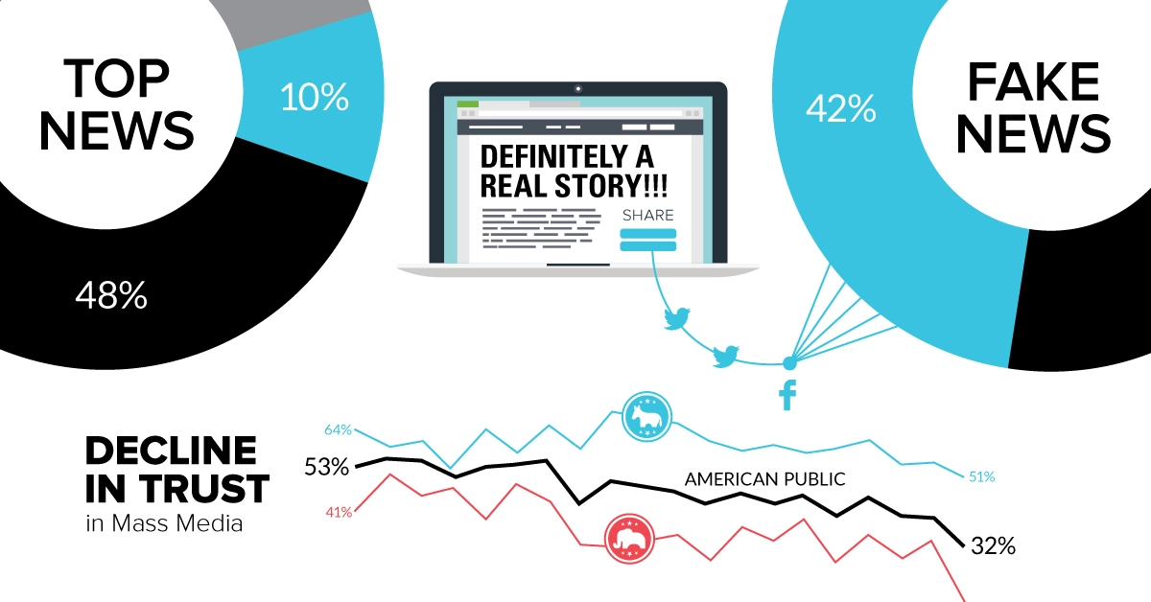

Slide 6
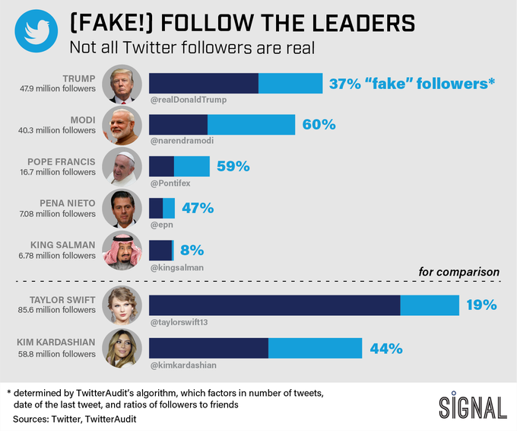

Slide 7
Motivation
There are many reasons why someone might want to create a fake tweet. Maybe they want to spread false information, or maybe they want to discredit someone.
Whatever the reason, fake tweets can have serious consequences, machine learning can help us detect fake tweets.
By looking at the features of a tweet, such as the text, the user and the date, we can train a machine-learning model to detect fake tweets.
This can help us avoid being fooled by fake tweets, and it can help us take action against the people who create them.

Slide 8
Literature Survey
The task of fake tweet detection can be approached in a number of ways, but machine learning is arguably the most effective.
A variety of machine-learning algorithms have been proposed for this task.
A number of studies have compared the effectiveness of different machine learning algorithms for fake tweet detection.

Slide 9
Summary of 20 articles
Sl. No. | Article Title | Authors | Journal | Methodology Used | Remarks
1 | Fake News Detection using Machine Learning | Pranita P. Deshmukh, Sakshi A. Dulhani , Parmita C. Adkane, Priyanka Y. Belekar | International Journal of Research in Engineering, Science and Management | Naïve bayes,Logistic regression,Support vector machine | We are considering the Multinomial Naive Bayes algorithm.
2 | The Detection of Fake Messages using Machine Learning | Maarten S. Looijenga | University Of Twente | Linear Support Vector Machines, Naïve Bayes, Decision Trees, Extra Trees, Stochastic Gradient Descent, Random Forests | These algorithm are computationally expensive and highly dependent on the size of an input data set.

Slide 10
Sl. No. | Article Title | Authors | Journal | Methodology Used | Remarks
3 | Can Fake News Detection Models Maintain the Performance through Time? A Longitudinal Evaluation of Twitter Publications | Nuno Guimarães, Álvaro Figueira, Luís Torgo | Mathematics Journal | Decision Tree, Naive Bayes, K-Nearest Neighbors | We are considering the Naive Bayes algorithm as well as Decision tree.
4 | A Novel Stacking Approach for Accurate Detection of Fake News | Tao Jiang, Jian Ping Li, Amin Ul Haq, Abdus Saboor, Amjad Ali | IEEE Access | Logistic Regression, Decision Tree, K-Nearest Neighbor,Random Forest, Convolutional Neural Networks | These methods had a much worse performance on small datasets.

Slide 11
Sl. No. | Article Title | Authors | Journal | Methodology Used | Remarks
5 | An Improved Multiple Features and Machine Learning-Based Approach for Detecting Clickbait News on Social Networks | Mohammed Al-Sarem, Faisal Saeed, Zeyad Ghaleb Al-Mekhlafi , Badiea Abdulkarem Mohammed , Mohammed Hadwan, Tawfik Al-Hadhrami ,Mohammad T. Alshammari, Abdulrahman Alreshidi, Talal Sarheed Alshammari | Applied Sciences Journal, published by MDPI | Multiple-feature-based approach Random Forest, Stochastic Gradient Descent, Support Vector Machine, Logistic Regression , Multinomial Naïve Bayes, K-nearest Neighbor | We are considering the Multinomial Naïve Bayes approach.

Slide 12
Sl. No. | Article Title | Authors | Journal | Methodology Used | Remarks
6 | Self Multi-Head Attention-based Convolutional Neural Networks for fake news detection | Yong Fang, Jian Gao, Cheng HuangID, Hua Peng, Runpu Wu | Open access journal, published by PLOS ONE | Convolutional Neural Network | These methods are time consuming and takes long time in training process.
7 | Fake Sentence Detection Based on Transfer Learning: Applying to Korean COVID-19 Fake News | Jeong-Wook Lee, Jae-Hoon Kim | Applied Sciences Article, published by MDPI | Bidirectional Encoder Representations from Transformers[B.E.R.T] with NLP | Slow to train because it is big and lots of weights to update.

Slide 13
Sl. No. | Article Title | Authors | Journal | Methodology Used | Remarks
8 | A comprehensive Benchmark for fake news detection | A. Galli, E. Masciari, V. Moscato, and G. Sperlí | Journal of Intelligent Information Systems (2022), published by springer | Stochastic Gradient Descent | Works wrongly due to the frequent updation in datasets.
9 | Collecting a Large Scale Dataset for Classifying Fake News Tweets Using Weak Supervision | Stefan Helmstetter and Heiko Paulheim | Future Internet article, published by MDPI | Naive Bayes, Decision Trees, Support Vector Machines | We are considering the Naive Bayes algorithm as well as the Decision tree.

Slide 14
Sl. No. | Article Title | Authors | Journal | Methodology Used | Remarks
10 | Deep Learning for Fake News Detection: A Comprehensive Survey | LinMei Hua, SiQi Weib, Ziwang Zhaob, Bin Wub | Journal Pre- proof, published by AI Open | DL-based FND method | These methods had a much worse performance and has vanishing gradient problem.
11 | Fake News Detection on Social Media using Deep learning and Semantic Knowledge Sources | Vian Sabeeh, Mohammed Zohdy, Atiqul Mollah Rasha Al Bashaireh | Journal of Computer Science IJCSIS, published by academia | SPOT Approach | Should extend this approach by exploring and selecting the useful features over the massive features

Slide 15
Sl. No. | Article Title | Authors | Journal | Methodology Used | Remarks
12 | Combining Machine Learning with Knowledge Engineering to detect Fake News in Social Networks-a survey | Sajjad Ahmed, Knut Hinkelmann, Flavio Corradini | CEUR Workshop | New Combination Algorithm Approach | Fake news detection organizations are required to update their strategies.
13 | Detecting Fake News Spreaders in Social Networks via Linguistic and Personality Features | Anu Shrestha, Francesca Spezzano, and Abishai Joy | CEUR Workshop | Ngrams, Empath Tool | Applicable to small dataset.

Slide 16
Sl. No. | Article Title | Authors | Journal | Methodology Used | Remarks
14 | A Benchmark Study on Machine Learning Methods for Fake News Detection | Junaed Younus Khan, Md. Tawkat Islam Khondaker, Anindya Iqbal, Sadia Afroz | Machine Learning with appliances, published by Research Gate | Features - Style, Ngrams | Hard to differentiate from users who never shared fake news.
15 | Analyzing User Profiles for Detection of Fake News Spreaders on Twitter | María S. Espinosa, Roberto Centeno, and Álvaro Rodrigo | Work. Notes CLEF 2020 - Conf. Labs Eval. Forum | Psychological, Linguistic traits,Twitter Actions Features & Headline Analysis Data | It needs an expectable performance when datasets vary.

Slide 17
Sl. No. | Article Title | Authors | Journal | Methodology Used | Remarks
16 | Fake News Detection on Social Media using Geometric Deep Learning | Federico Monti, Fabrizio Frasca,Davide Eynard,Damon Mannion,Michael M. Bronstein | Published by arxiv.org | Fruchterman-Reingold force-directed algorithm. | It works accurately with large data and not limited data.
17 | Credibility Analysis on Twitter Considering Topic Detection | Maria , Ana Aguilera, Irvin Dongo,Jose Cornejo-Lupa,Yudith Cardinale | Applied Sciences Article, published by MDPI | Clustering,frequent pattern mining ,exemplar based,matrix factorization,probabilistics techniques. | This approach uses twitter API where they provide limited amount of data (900 tweets per 15 min).
18 | Fake News Analysis Modeling Using Quote Retweet | Y. Jang, C. H. Park, and Y. S. Seo | Electronics Article, published by MDPI | Quote Retweet feature | It is not prone to work on new features introduced in Twitter

Slide 18
Sl. No. | Article Title | Authors | Journal | Methodology Used | Remarks
19 | Fake News Data Exploration and Analytics | Mazhar Javed Awan, Awais Yasin, Haitham Nobanee,Ahmed Abid Ali, ZainShahzad,Muhammad Nabeel, Azlan Mohd Zain, Hafiz Muhammad Faisal Shahzad | Electronics Article, published by MDPI | Pre-processed and extensive data exploration,automatic detection approaches based on deep learning and machine learning | We are considering the decision tree classifier method.
20 | Deep Learning for Fake News Detection in a Pairwise Textual Input Schema | Despoina Mouratidis , Maria Nefeli Nikiforos, Katia Kermanidis | ComputationArticle, published by MDPI | Two tweets method, Naive Bayes and selection methodology. | We are considering the Naive Bayes algorithm as well as the Decision tree.

Slide 19
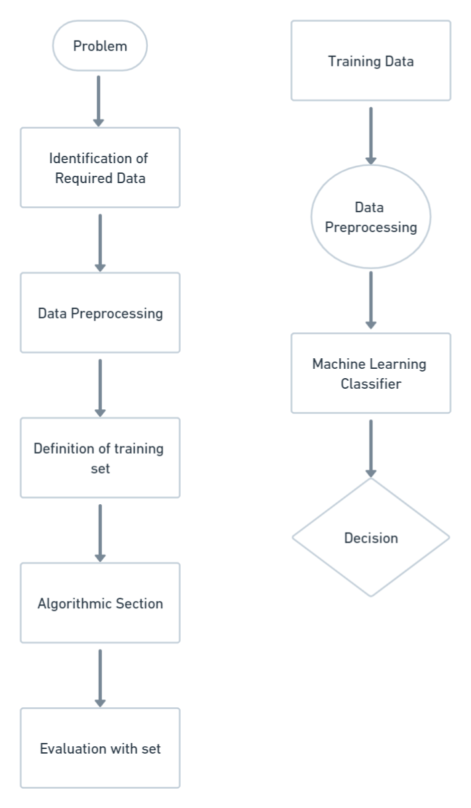
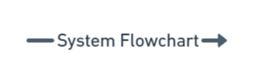

Flowchart

Slide 20
Conclusion
After going through all the papers above we have come to a conclusion that we are going with the Multinomial Naïve Bayes approach in the rest of the project phase.The reason for concluding is,the paper we referred itself concluded saying they received accuracy rates as follows:
Passive Aggressive Classifier(91.11%)
Naive Bayes Classifier(91.3%)
Logistic Regression(93.11%)
Decision Tree(94.97%)
Multinomial Naive Bayes algorithm is a probabilistic learning method that is mostly used in Natural Language Processing (NLP). The algorithm is based on the Bayes theorem and predicts the tag of a text such as a piece of email or newspaper article. It calculates the probability of each tag for a given sample and then gives the tag with the highest probability as output.

Slide 21
References
IEEE Explore
https://ieeexplore.ieee.org/xpl/aboutJournal.jsp?punumber=6287639
MDPI
https://www.mdpi.com/
Google Scholar
https://scholar.google.com/

